Slide 1




Introduction to bioinformatics
Haniel Cedraz
hanielcedraz@gmail.com

Slide 2
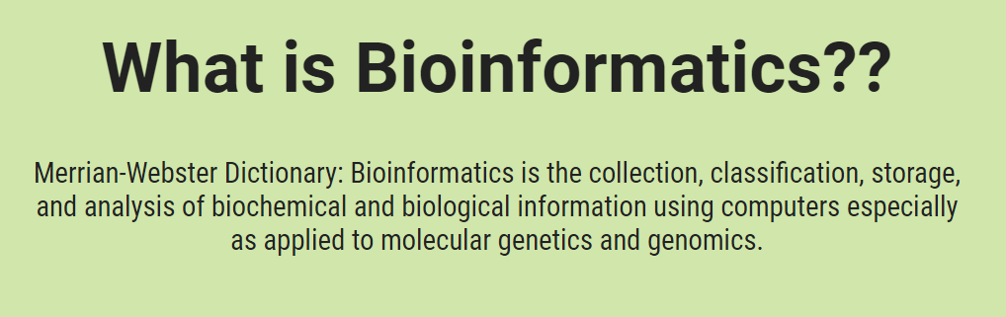
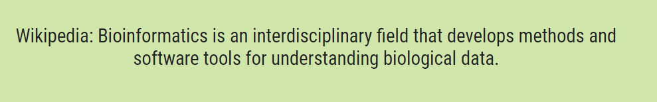
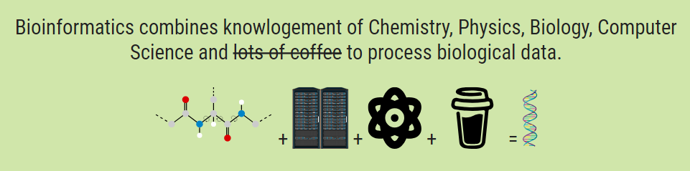

Slide 3
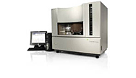

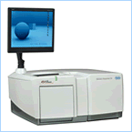
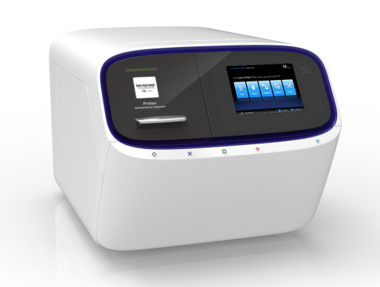

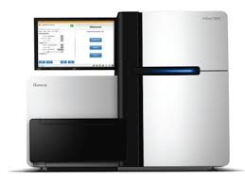
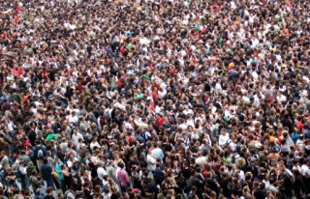
Sequencing Technologies – Making data
ABI 3730
384 Reads
308 kb/Sequencing
10.400 Sequencing = 1 HG
Roche / 454
1 Million of Reads
600 Mb/Sequencing
6 Sequencing = 1 HG
Ion Proton
80 Million of Reads
10 Gb/Sequencing
1 Sequencing = 3 HG
Illumina - HiSeq
8 Billions of Reads
1 Tb/Sequencing
1 Sequencing = 310 HG

Slide 4
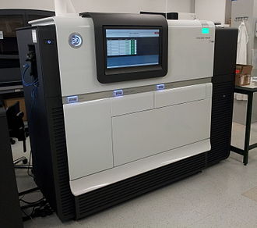
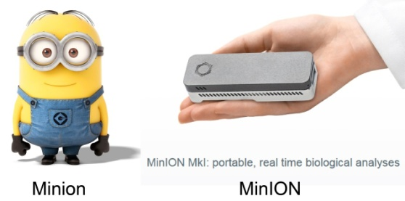

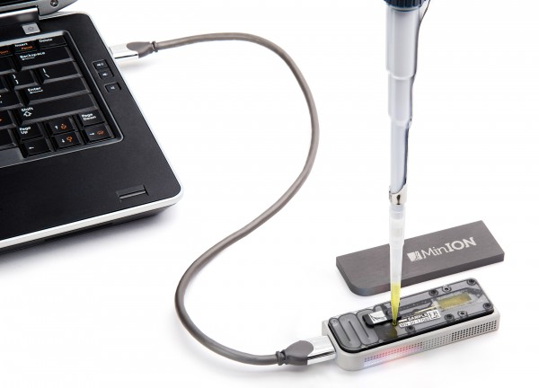
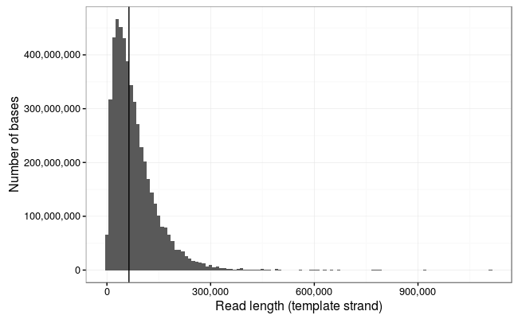
Sequencing Technologies (Long reads)
Pacific Biosciences
500 thousands of Reads
10 Gb/Sequencing
Long Fragments: 10 – 15 kb
Max: 40 Kb
NanoPore
50 thousands of Reads
10 – 20 Gb/Sequencing
Long Fragments : 50 – 100kb
Max: 800 Kb

Slide 5
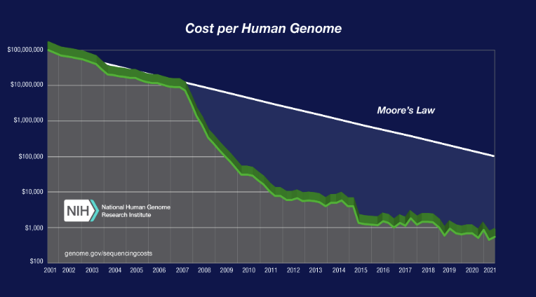
Cost per genome data - 2021

Slide 6
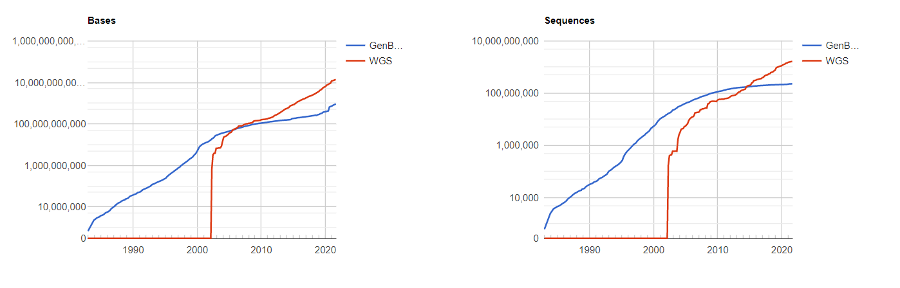
Growth of Genbank and WGS
(1982-2022)
 |  | GenBank |  | WGS
Release | Date | Bases | Sequences | Bases | Sequences
3 | Dec-82 | 680.34 Kb | 606 K
14 | Nov-83 | 2.27 Mb | 2427 K
129 | Apr-02 | 19.07 Gb | 16 Mi | 692.27 Mb | 172 K
130 | Jun-02 | 20.65 Gb | 17 Mi | 3.27 Gb | 397 K
244 | Jun-21 | 866.01 Gb | 227 Mi | 13.4 Tb | 1.63 Bi
245 | Aug-21 | 940.51 Gb | 231 Mi | 13.8 Tb | 1.65 Bi
252 | Oct-22 | 1562.96 Gb | 240 Mi | 18.2 Tb | 2.1 Bi
ncbi - genbank - statistics

Slide 7
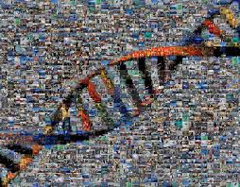
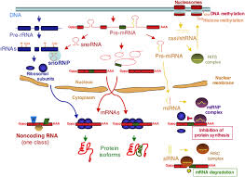
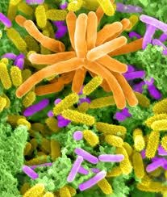
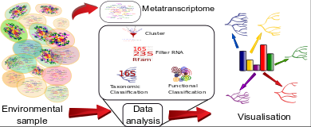
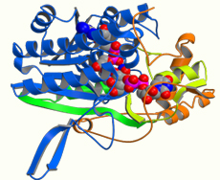
Bioinformatics project
Genome(omics)
Transcriptome(omics)
Metagenome(omics)
Metatranscriptome(omics)
Proteome(omics)

Slide 8
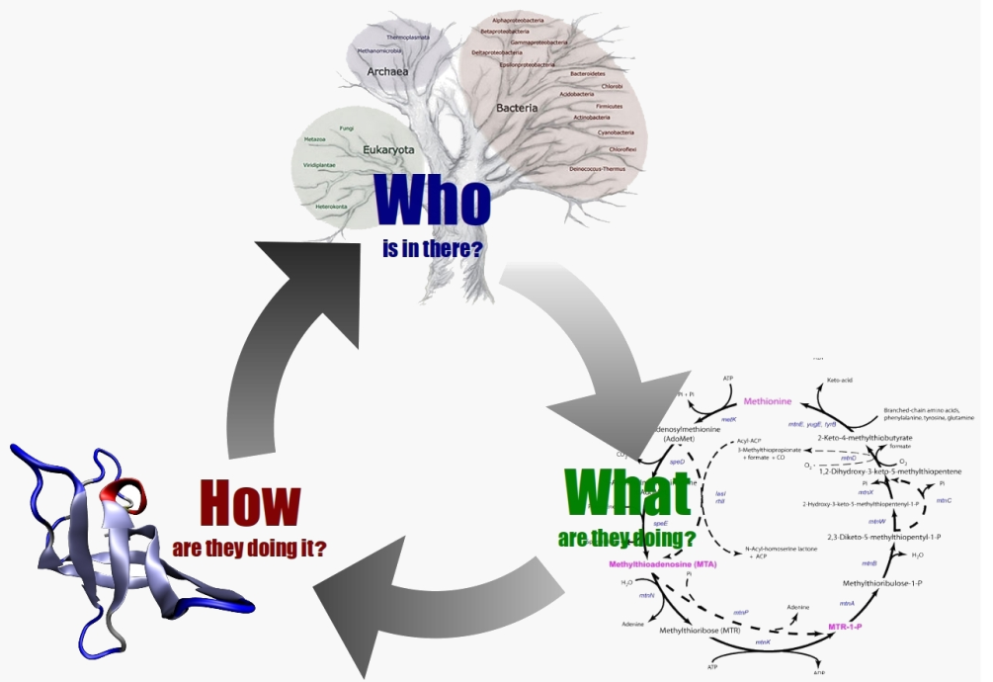
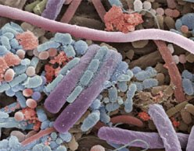
Metagenomics: exploring the unseen
Metagenome
Metagenomics
The set of microbiome genome in a specific environment.
- It permits to access genes of uncultured bacteria in different environments.
Genomic analysis of microbiome in a specific environment.

Slide 9
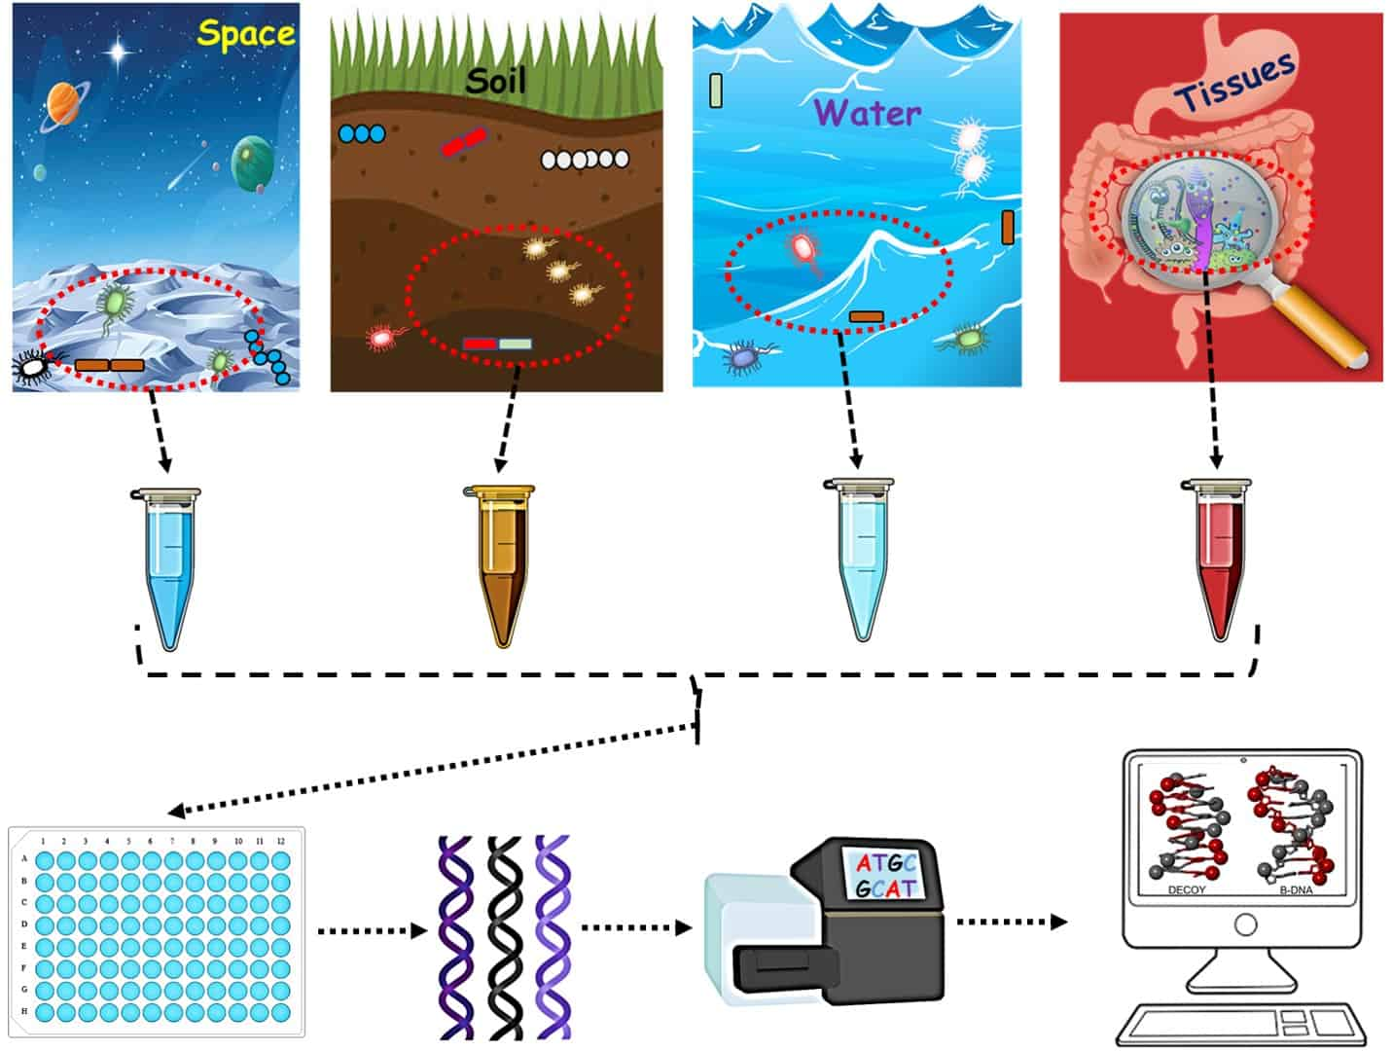

Slide 10
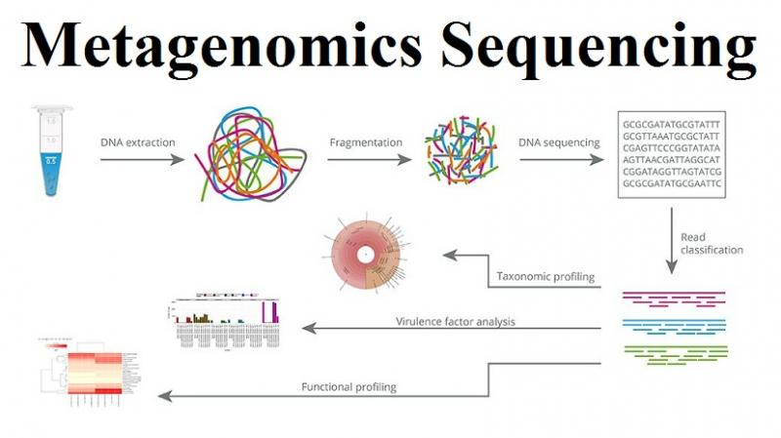

Slide 11
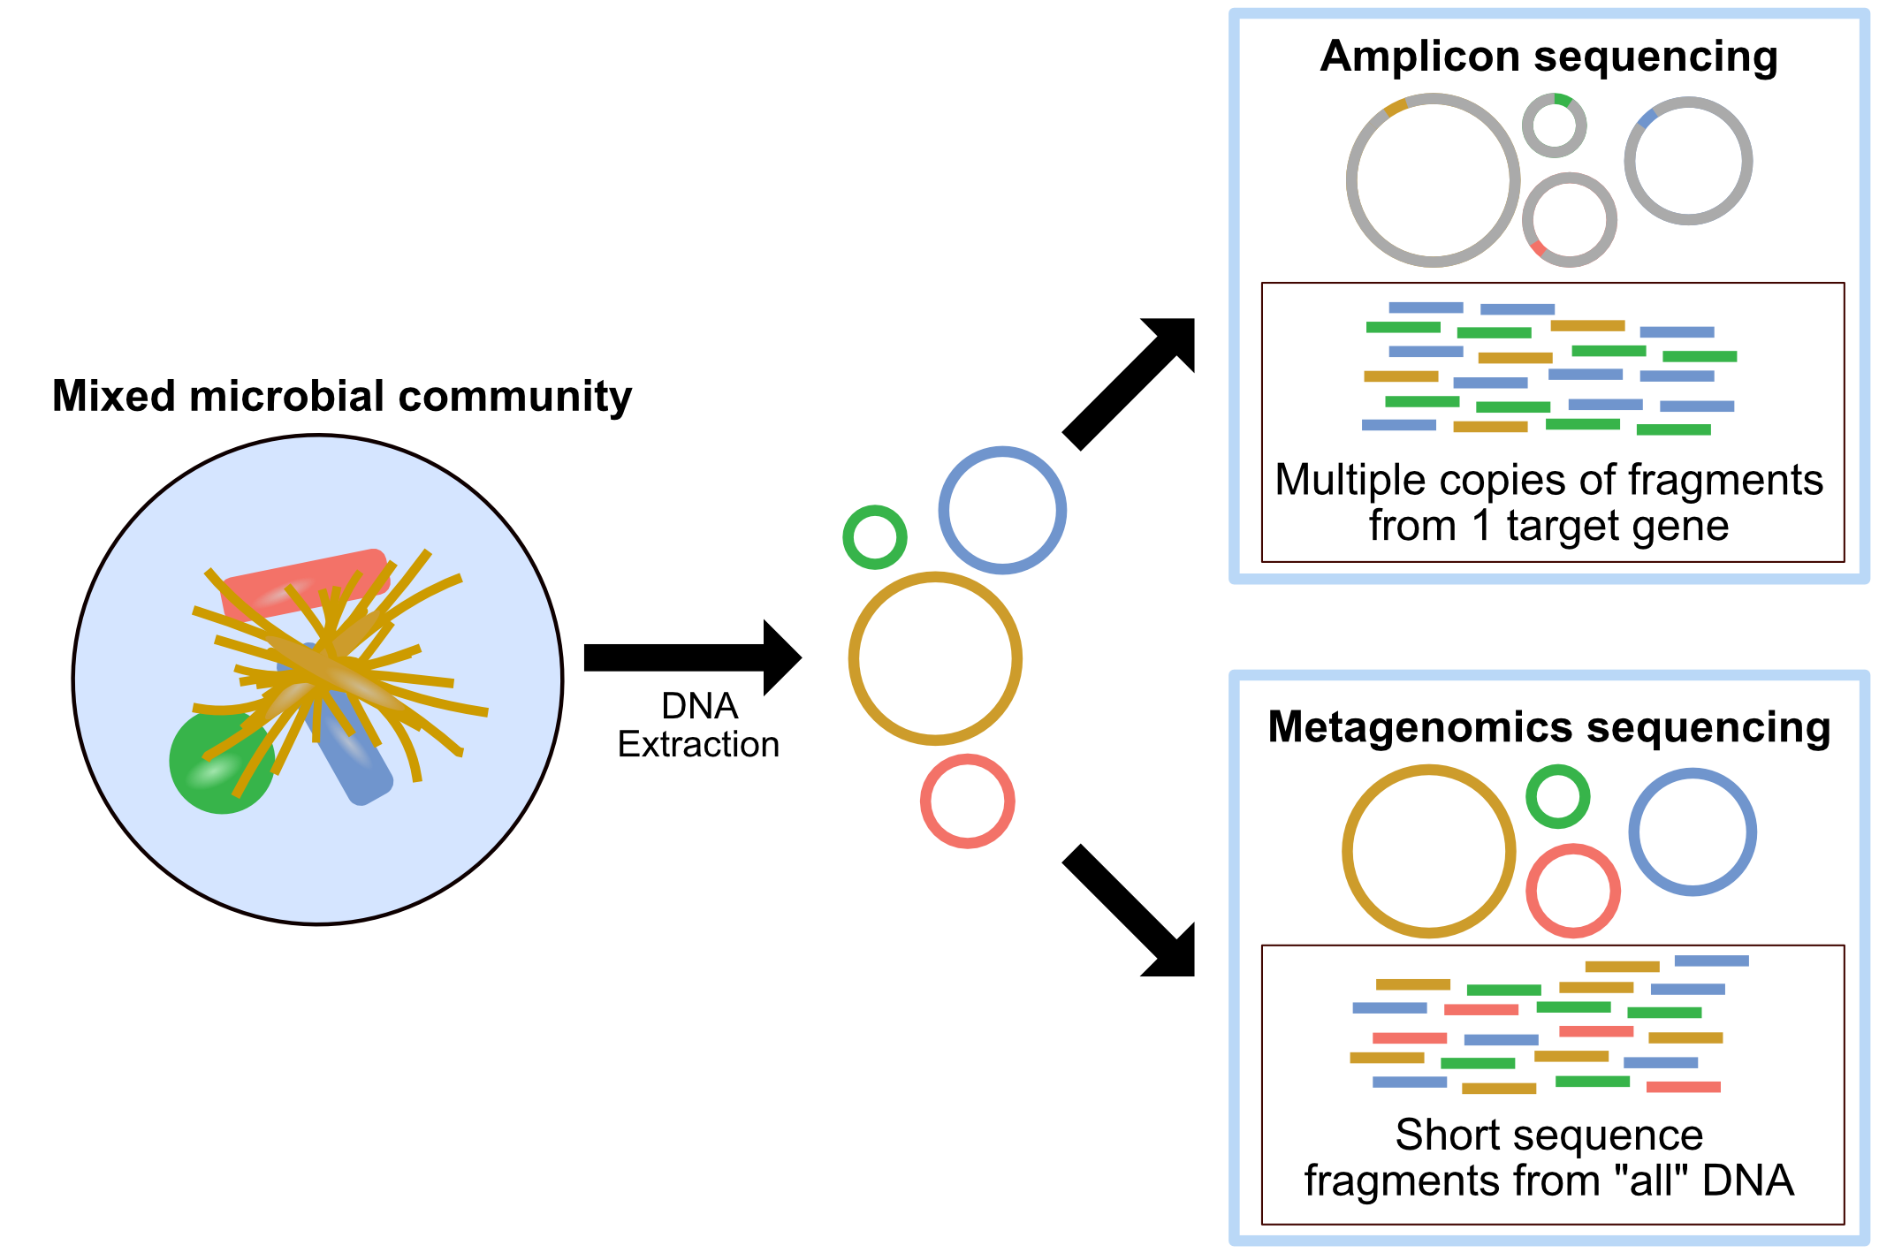

Slide 12
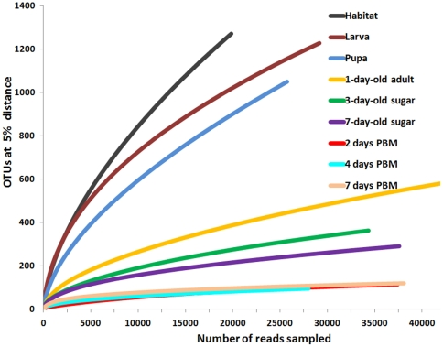
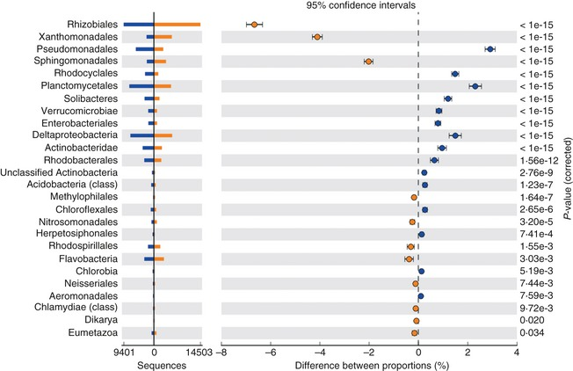
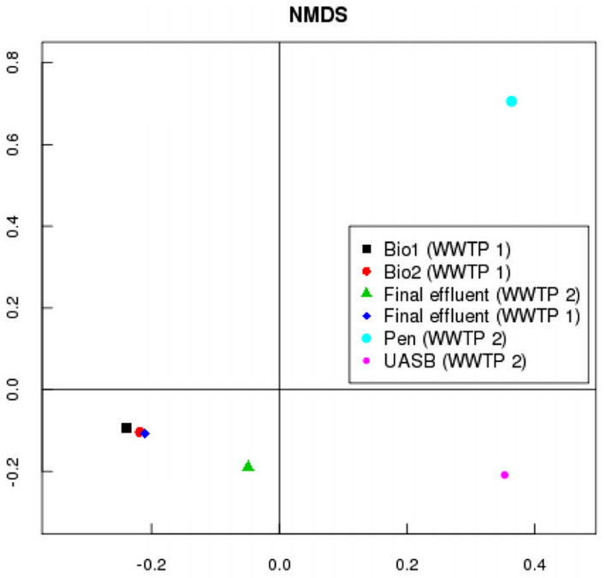
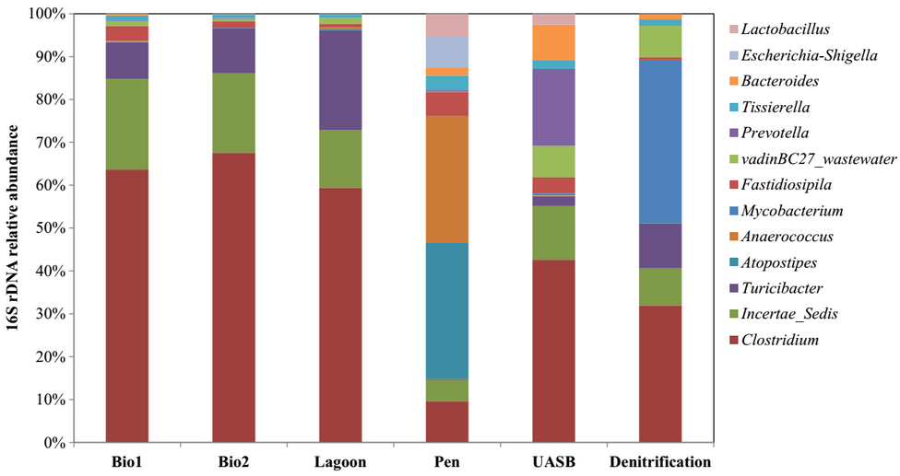

Slide 13
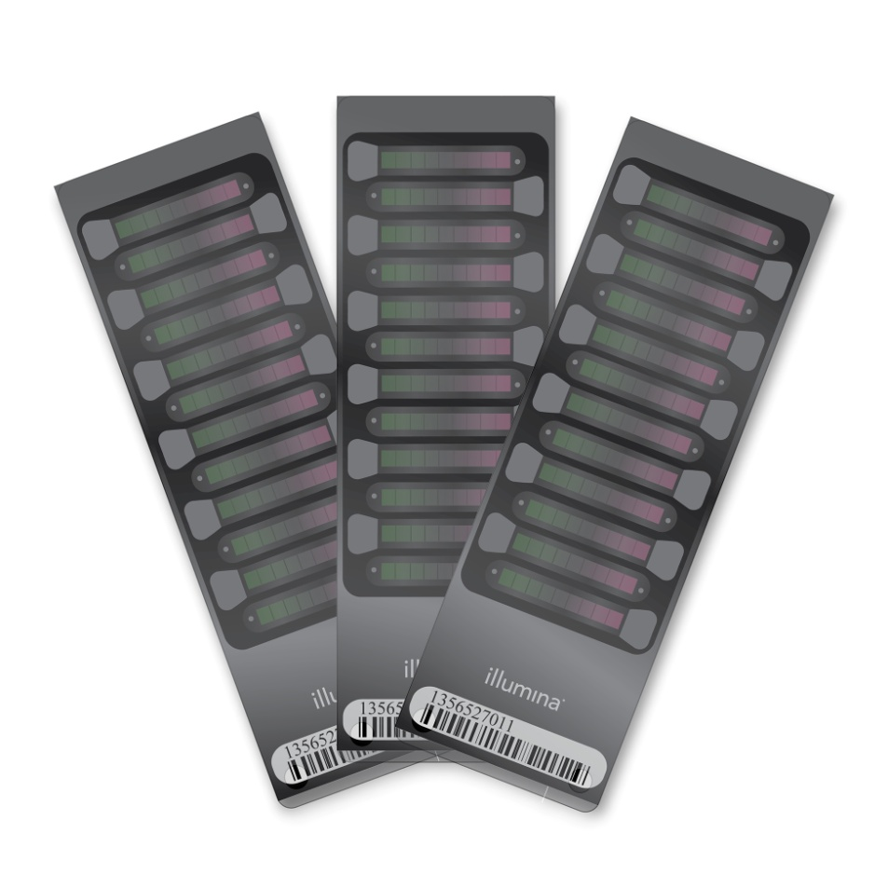
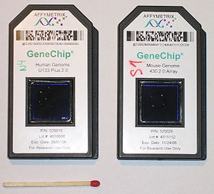
Genome-Wide Association Studies (GWAS)
Genetic variation study in different individuals;
SNPs or genomic region associated with a phenotype;
FineMapping the Associated Region;
Using other “omics” such as transcriptome, epigenome;
Using WSG to increase the SNP density;

Slide 14
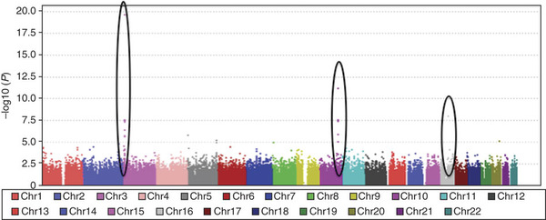

Slide 15
Transcriptome

Slide 16
What is transcriptome ?
Transcriptome is the collection of RNAs in a cell/tissue in a specific moment.
It is the fraction of the genetic code (DNA) that is transcript by the polymerase RNA into RNA molecule
It depends on the development stage, fisiological stage and the type of the tissue.

Slide 17
What is transcriptomics ?
Transcriptomics is the analysis itself of the RNA collection
Quantify the expression;
Identify the Differentially Expressed Genes

Slide 18
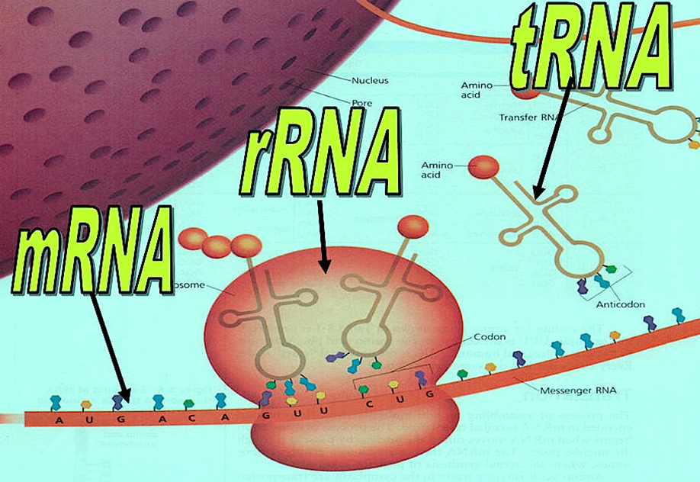
Types of RNA

Slide 19
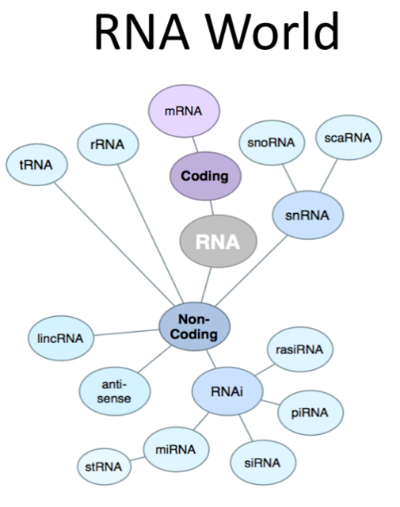
small nucleolar RNAs (snoRNAs)
small cajal body-specific RNA (scaRNA)
small nuclear RNA (snRNA)
long intervening noncoding RNAs (lincRNAs)
antisense RNA (asRNA)
small temporal RNA (stRNA)
microRNA (miRNA)
RNA interference (RNAi)
small interfering RNA (siRNA)
piwi-interacting RNA (piRNA)
repeat associated small interfering RNA (rasiRNA)

Slide 20
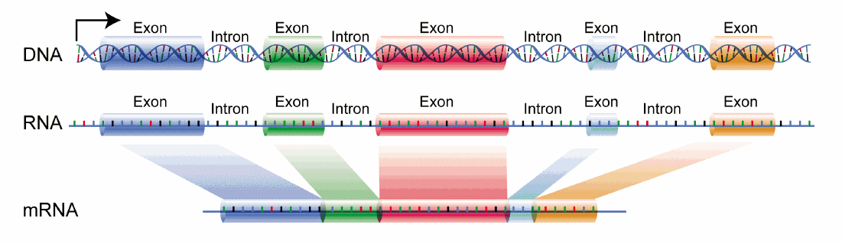
Basic transcription process in Eucaryotes

Slide 21
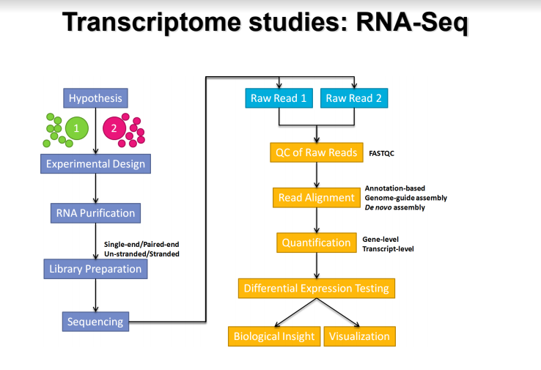

Slide 22



PIPELINE
Hypothesis/Idea
Library prep
Sequencing and Data Analysis

Slide 23
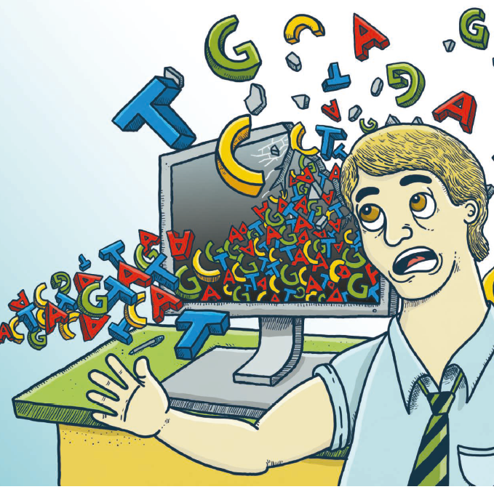
Experimental Design
You get what you give:
Sample prep;
RNA Extraction;
cDNA library
Quality;
Integrity;
Quantity;
Sequencing
Deep

Slide 24


Bioinformatics Analysis

Slide 25
What do you need?
Access to a multi-core (24+ threads) and 64+ Gb of RAM Linux server;
Basic acknowledgement in software installation;
Be familiar with Command line terminal;
Basic acknowledgement in computer programing (Shell, R, Python, perl);
Basic acknowledgement of statistics and models;

Slide 26













The command line
The command line is a powerful and it is the indicated method to run bioinformatics tools.
BASIC:
Prompt haniel@DESKTOP-8N6BLFP:~$
~ It is your home directory
... $ command [parameters] [files] ENTER
The parameters start with a –ShortPar or --LongPar
Help ... $ man command
… $ command -h
… $ command --help

Slide 27
The command Line
pwd – Print the work directory (current dir);
ls [file/dir] – list all content in a directory;
ls -l [file/dir] – Long list. Show hidden files;
cd - Change Directory;
cp f1 f2 – Copy file f1 to file f2;
mv home/f1 new_directory/f1 – Move file from a directory to another;
mv f1 f2 – Rename file f1 to file f2;
When name files or directory avoid special character and spaces. Use dot (.), Underscore (_) between words or CamelCase!!

Slide 28

mkdir dir – Create a new folder;
rm arquivo – Delete file;
rmdir dir – Delete empty folder;
rm -rf dir – Force delete nonempty;
Nano/vi file.txt – Text editor;
cat f1 [f2] – print file f1 and concatenate into file f2;
less file – print one page a time;
head file – print the first 10 rows;
tail file – Print the last 10 rows;

Slide 29
The command line
Special Character:
| Vertical bar, called “pipe”, it indicates that finish a command and start another;
< > In and out of a command;
>> Append contente;
. Current dir
.. Back one dir;
/ Folder Delimiter;
* Wild character, used in the beggining or end of a command;

Slide 30
Bioinformatics Analysis

Slide 31
Quality Control
Remove contaminants;
Trim sequences;
Remove polyA/T tails;
Join sequences (pair end);
Remove small reads (according to the parameters);
trimmomatic; fastp...

Slide 32
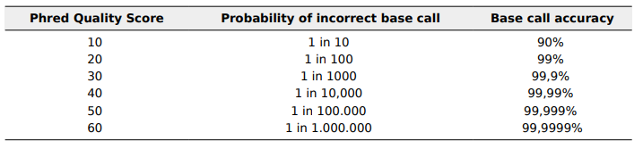
FASTA format
Text file used to store biological sequences such as nucleotides and amino acids.
Exemples:
>Sequence_Name
ATGCATGTGCAGGTCGATCGAGCATGCATGCACGATCGATGCATCATGCTAGCATCGATGTGCATGCTAG*
>Sequence_Name_Qual_File
37 37 37 37 37 28 28 28 28 37 34 35 35 35 34 34 34 34 34 35 35 33 35 35 32 25 25 25 25 27 27 27 29 29 29 29 25 13 13 13 17 17 22 18 20 11

Slide 33
FASTQ Format
Instead of two file (one to the sequence and one to the quality), the FASTq file was created to join the two files into a single one.
Reducing space in disk.

Slide 34
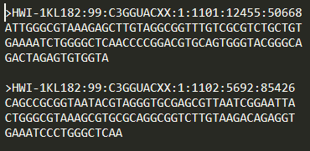
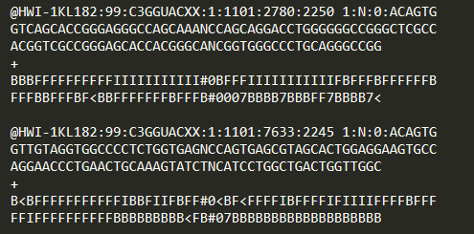
FASTA File
FASTQ File

Slide 35
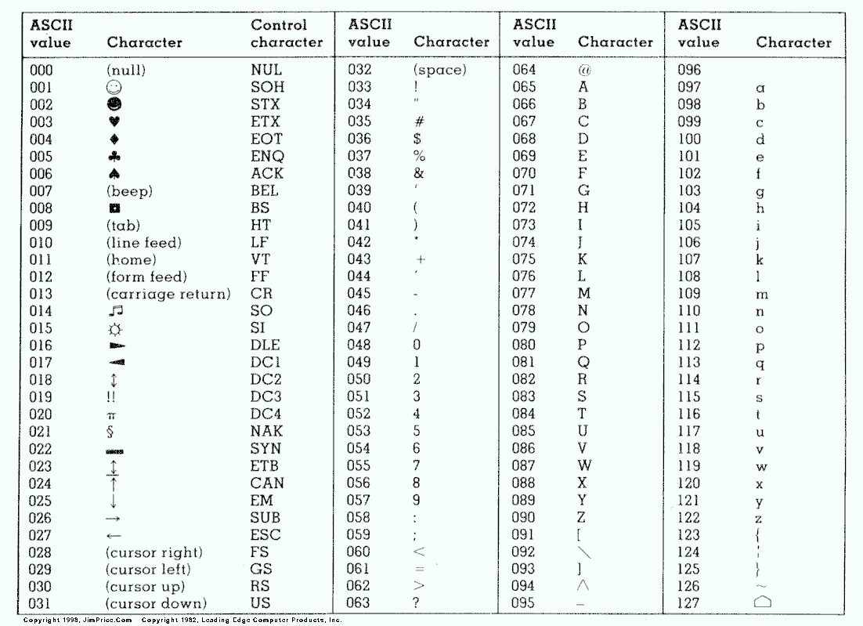
Table ASCII
To know the quality value for each base > the letter in the ASCII code and subtract by 33.

Slide 36
The ASCII value “C” is 67, then, Where is C replace it for 33;
“C” means Phred qualiy = 34; (67 – 33 = 34)
@SEQ_ID
GATTTGGGGTTCAAAGCAGTATCGATCAAATAGTCAACTCACAG
+
C''*((((***+))%%%++)(%%%%).1***-+*''))**55CCF>>>>>>CCCCCC
34''*((((***+))%%%++)(%%%%).1***-+*''))**553434F>>>>>>343434343434

Slide 37
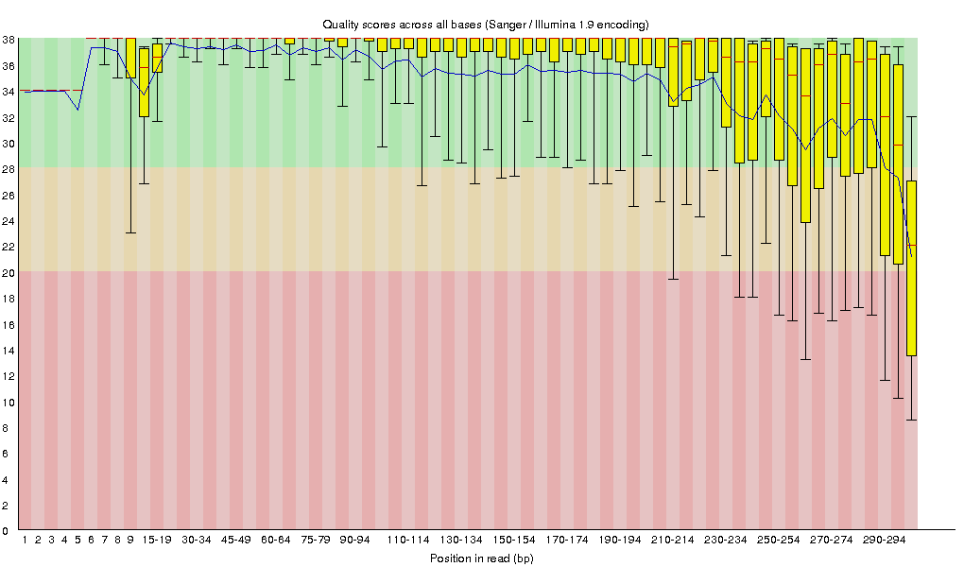

Slide 38
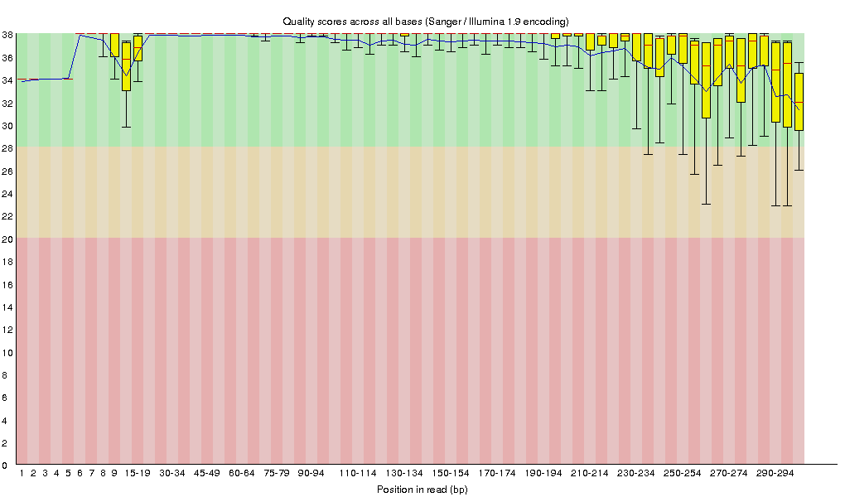

Slide 39
Mapping vs Assembly
ALIGNMENT: Comparing two or more sequencies by characters or patterns in the same order.
A L I G N M E N T
| | | | | | |
- L I G A M E N T

Slide 40

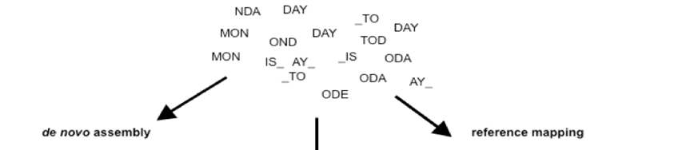
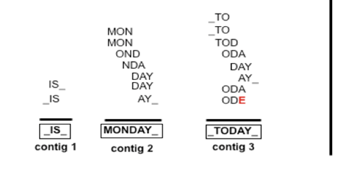
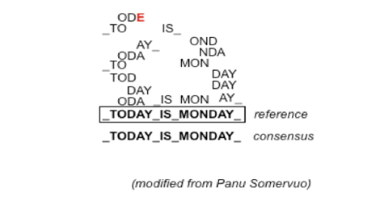
Assembly:
Solve the puzzle WITHOUT a reference.
Mapping:
Solve the puzzle WITH a reference.

Slide 41
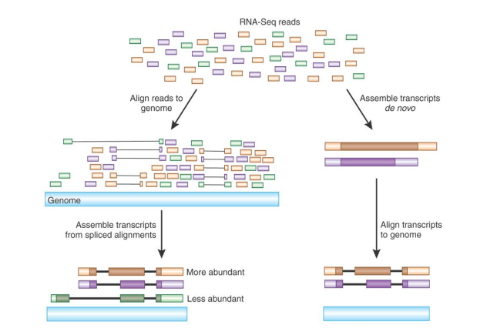

Slide 42
Aligners
Tophat;
HISAT2;
STAR;
Bowtie2
bwa-mem

Slide 43
Reads Counting
The more you can count, the better the measure of copy number will be, even for rare transcripts in a population.
Most RNA-seq techniques deal with count data. Reads are mapped to a reference genome. Transcripts are detected and the number of reads that map to a transcript (or gene) is counted.
The counted reads from a transcript are approximately proportional to the length of the gene and the abundance of the transcript.

Slide 44
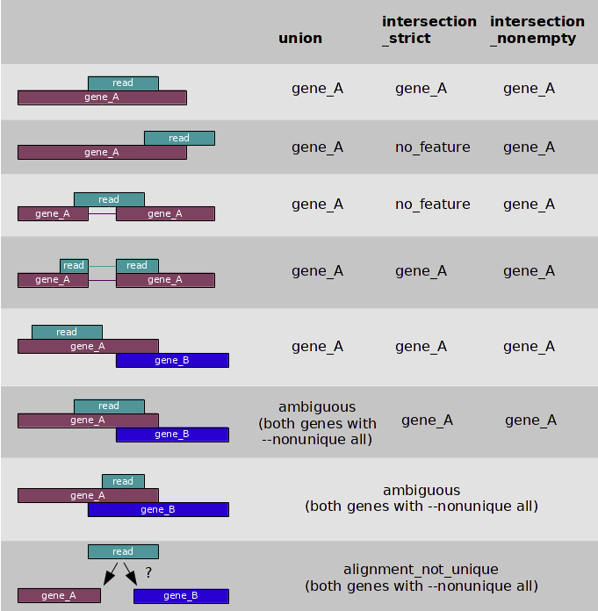
https://htseq.readthedocs.io/en/master/count.html

Slide 45
STAR
HT-SeqCounts
FeatureCounts
Reads Counter

Slide 46
Application
Association Studies;
Assembling new reference genomes;
Population;
Breed;
Pangenome;
Improving gene annotation

Slide 47
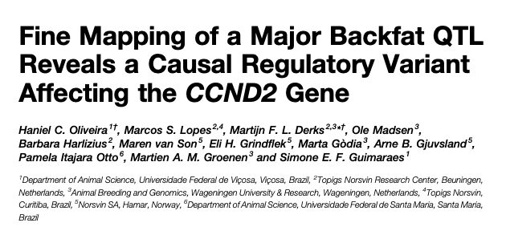
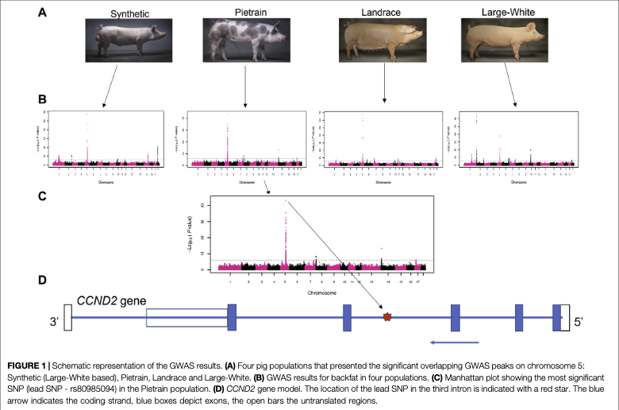
Data
Genotypes;
Phenotypes;
DNA-Seq;
RNA-Seq;
ChIP-Seq;

Slide 48
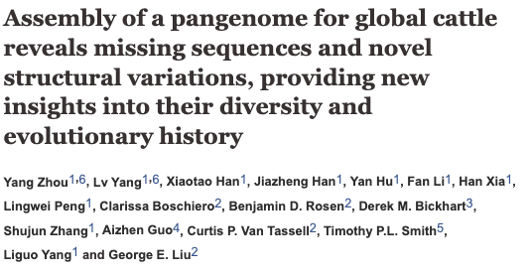
A cattle pangenome representation was created based on the genome sequences of 898 cattle representing 57 breeds.

Slide 49





Slide 50
Role of a bioinformatician in industry
Data management;
Pipeline development;
NGS analysis;
Imputation;
Mapping;
Coverage calculation;

Slide 51
Hands on the keyboard

